Slide 1


Slide 2
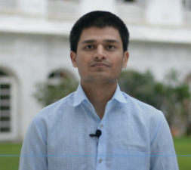
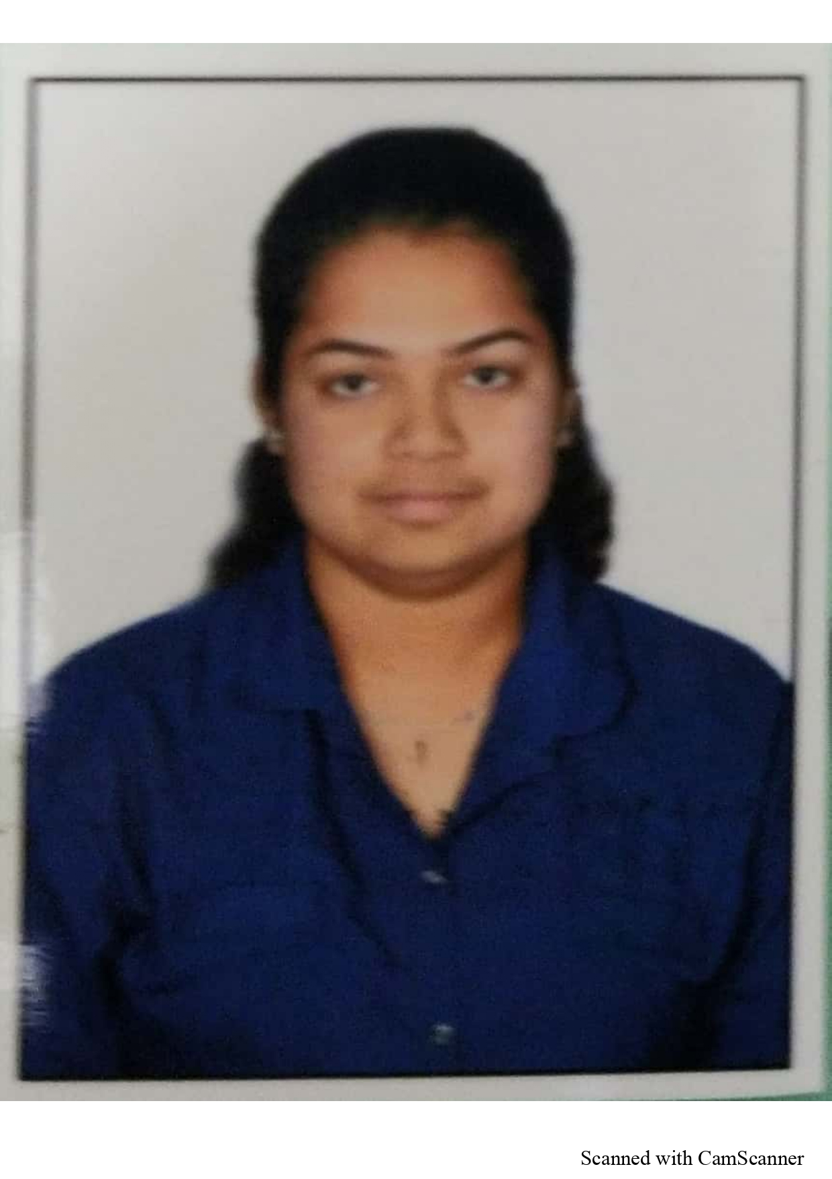
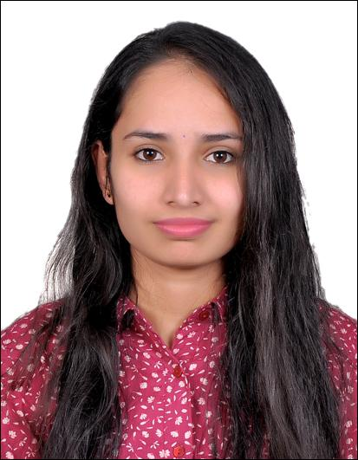
Project Highlights
Project Name : Multi Function Application
Team Size : 3
BU Mentor Name : Roshan Noronha, ,Milind Hatkhamkar
Team Members Details :
Intern Name – Shrikant Barkale
PS# 99002458
GENESIS Track Code - 2009BLRICP01
Education Details – B.E ECE
Professional Skills – Team Player, Mentoring
Intern Name – Akshata Chandrakant Shet
PS# 99002465
GENESIS Track Code - 2009BLRICP01
Education Details – B.E ECE
Professional Skills – Team Player, Mentoring
Intern Name – Bindu K R
PS# 99002454
GENESIS Track Code – 2009BLRICP01
Education Details – B.E, EE
Professional Skills – Teamwork, Time Management

Slide 3
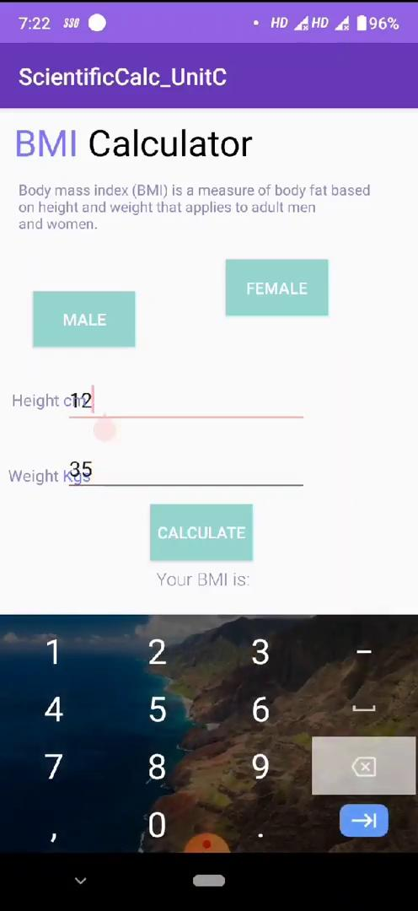
Project Video Snippet
https://drive.google.com/file/d/1t505cvTRo-pcUodAEQdLeg8EI9F0991v/view?usp=sharing/

Slide 4
Future development that can be implemented further
First we can make UI more attractive
More Apps can be added as we learn more in Android Development
Scientific Calculator is not keeping history of past operation
More functionalities can be added for unit converter.
BMI_Calculator GUI can be improved.

Slide 5

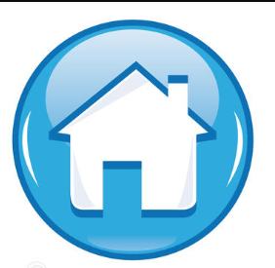
Thank You !

